Slide 1
Foundations of Comparative Analytics for Uncertainty in Graphs
Lise Getoor, University of Maryland
Alex Pang, UC Santa Cruz
Lisa Singh, Georgetown University
Notes:
This talk introduces our initial work on Probabilistic Similarity Logic (or PSL for short), an SRL type framework which facilitates reasoning about imprecision and similarity in a relational setting. In addition to this extra layer of expressiveness, we show that our proposal of PSL allows for tractable and practical inference. PSL arose from joint work with Lise Getoor at UMD on a problem which inherently exhibits imprecision.
30 second elevator pitch to give people an idea of what is ahead and why they should be excited about it:

Slide 2
Overview
Mathematical Foundations
  Probabilistic Soft Logic (PSL)
Comparative Operators
  Structural and semantic operators
Comparative Visual Analytics of Uncertain Graphs
  Novel, linked views

Slide 3
Applications
Personalized medicine
Dog kennel data
Dolphin social networking
Ontology alignment
Diffusion modeling
…

Slide 4
PSL Overview

Slide 5
What is PSL?
Declarative language based on logic to express collective probabilistic inference problems
  Predicate = relationship or property
  (Ground) Atom = (continuous) random variable
  Rule = capture dependency or constraint
  Set = define aggregates
PSL Program = Rules, Sets, Constraints, Atoms

Slide 6
Collective Similarity Reasoning
Data Space
Soft Space
Model
Formal (Logic) Language
Structure
Weights
Inference
MAP / Marginal
Weight / Structure
Learning
Relations, Text, Factoids, Images, etc
Notes:
Uai paper showing exact inferences are tractable
Nips paper showing marginal probabilities are tractable (in practice)

Slide 7
PSL Implementation
Implemented in Java / Groovy
~40k lines of code, but still alpha
Performance oriented
  Database backend
  Memory efficient data structures
  High performance solver integration
Notes:
We use Groovy to implement a DSL (domain specific language) for specifying PSL models

Slide 8
Comparative Operators

Slide 9
Comparing Models
Output of PSL and other SRL systems can be viewed as an uncertain graph
  Uncertainty attribute values
  Uncertainty over edges
  Uncertainty over node labels and existence
Want methods for comparing, constrasting and understanding the output of two different models.

Slide 10
Operators for Comparing Uncertain Graphs
Compare two graphs at different levels: attribute level, element level, ego network level, and graph level.
Output of operators used as input to comparative visualizations.
Example operators
  Structural similarity
    Similarity between the general shape of two distributions. Calculated using a ratio of entropy values and ratio of absolute distances.
  Semantic similarity
    Similarity between the probability of different values of two distributions. Calculated using KL-divergence, histogram intersection, and Minkowski-Form distance. Investigating extensions for ego network and graph level comparisons.
  About 25 operators identified and being developed

Slide 11
Comparative Visual Analytics
Notes:
Pictures:
[1] Google Image search for “ontology” on Nov 29th, 2010
[2] Image from flickr: http://www.flickr.com/photos/rmgimages/4882443448/, copyright of Keith Ramsey (RambergMediaImages)
[3]

Slide 12
Coordinated Views (work in progress)
Table View : Compare feature values from both models.
Ego View : Node-link diagram of ego networks of selected node(s).
OverView: Comparative column and bullseye views of both models
others

Slide 13
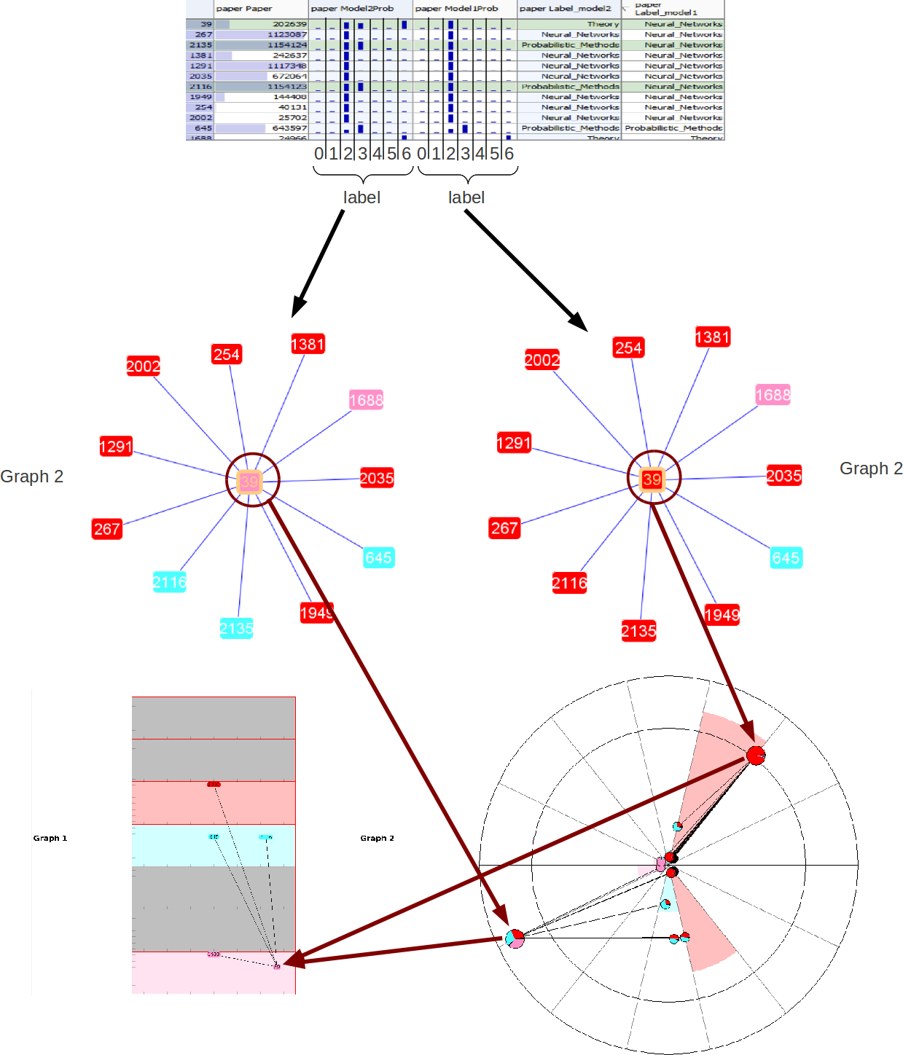

Slide 14
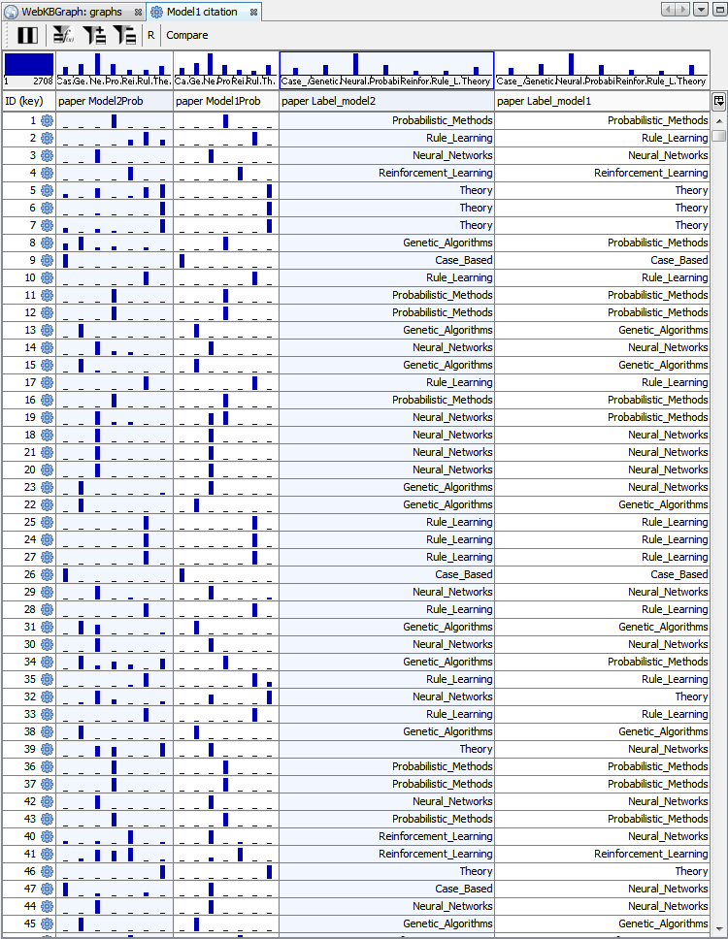
Table View

Slide 15
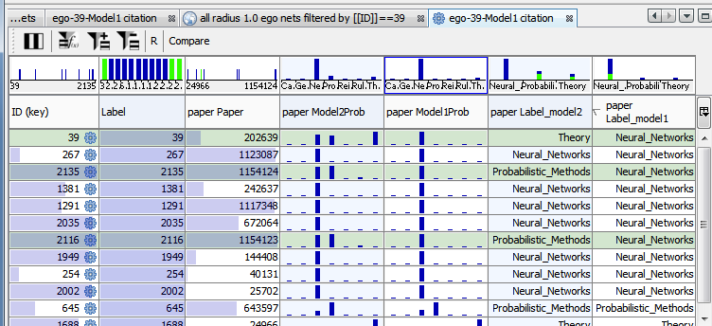
Filtering in Table View

Slide 16
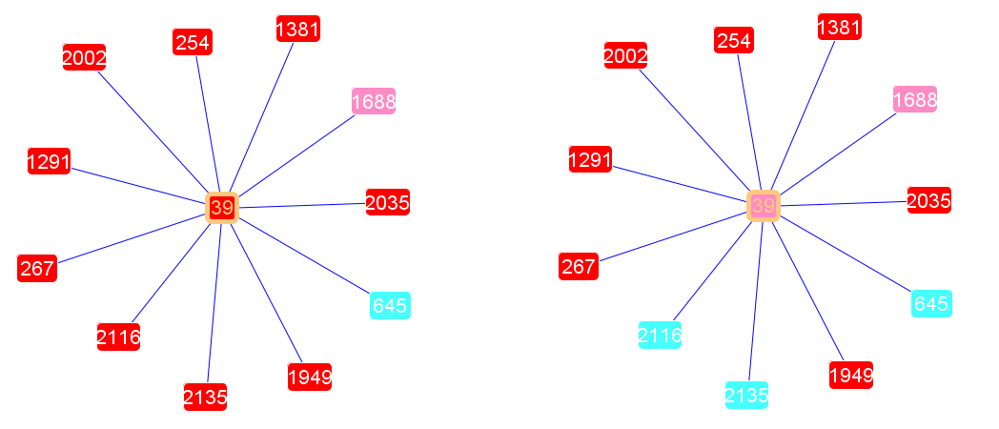
Ego View: Side-by-Side
Model 1 Model 2
Nodes: Paper, Edges: Citation
Node Labels: Red=Neural Network , Blue=Probabilistic Learning, Pink=Theory
Notes:
Model 1 Model 2 : relational, non-relational features used

Slide 17
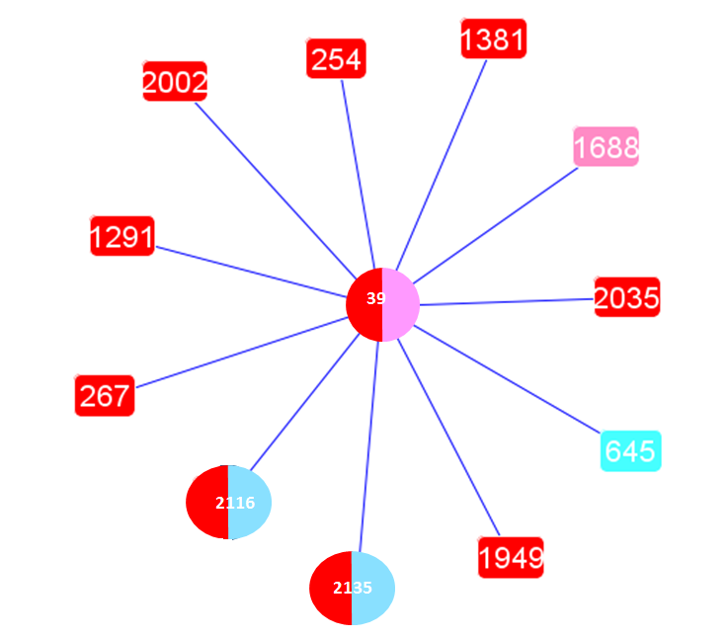
Ego View: Overlaid
Model 1 and Model 2 in the same diagram
Notes:
Bi-color nodes are those whose labels do not agree.
Shape eccentricity indicates the difference of distribution curve of two models. Node is circular when both models’ distributions are more similar, elliptical when they are different.

Slide 18
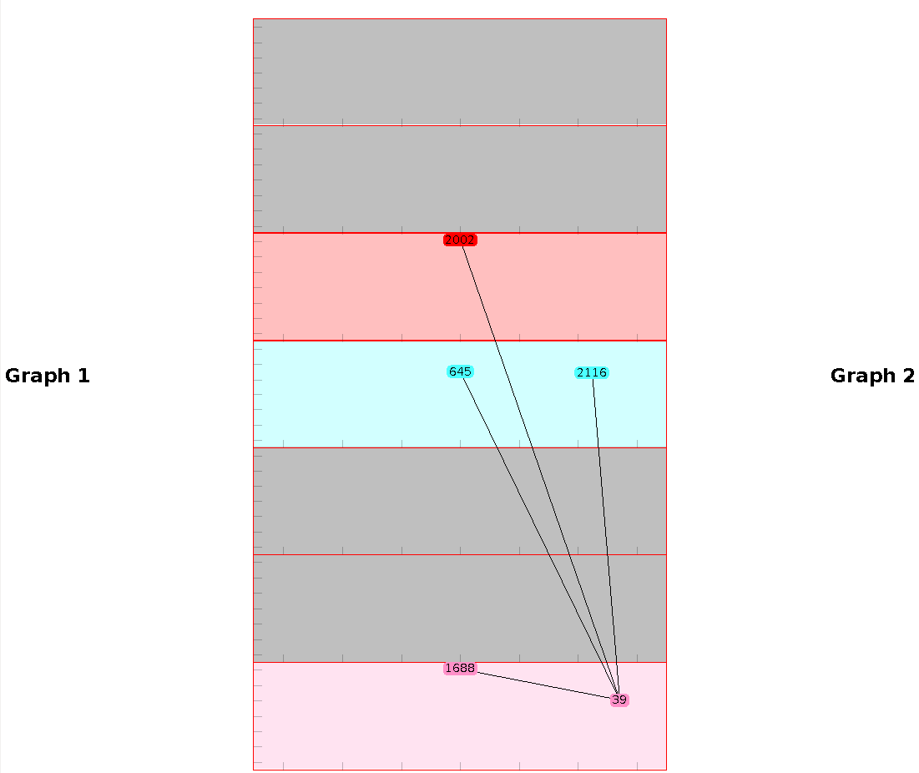
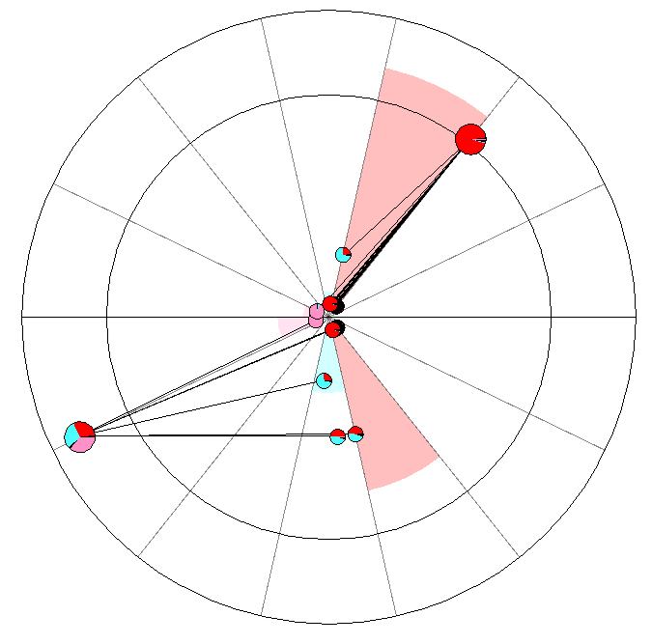
OverView

Slide 19
System Overview
Data & Programs
PSL
PSL
Other Statistical Relational Learning Software
…
Comparative Analysis
Visual Analytics of Uncertain Graphs

Slide 20
References

Slide 21
References
[1] Visualizing Node Attribute Uncertainty in Graphs, Nathaniel Cesario, Alex Pang, and Lisa Singh, SPIE Conference on Visualization and Data Analysis (VDA) 2011
[2] Comparative Visual Analytics for Network Data, Lise Getoor, Invited talk at NIPS Workshop on Challenges in Data Visualization, 2010
[3] Computing marginal distributions over continuous Markov networks for statistical relational learning, Matthias Broecheler, and Lise Getoor, Advances in Neural Information Processing Systems (NIPS) 2010
[4] A Scalable Framework for Modeling Competitive Diffusion in Social Networks,
Matthias Broecheler, Paulo Shakarian, and V.S. Subrahmanian, International Conference on Social Computing (SocialCom) 2010, Symposium Section
[5] Probabilistic Similarity Logic, Matthias Broecheler, Lilyana Mihalkova and Lise Getoor, Conference on Uncertainty in Artificial Intelligence 2010
[6] Decision-Driven Models with Probabilistic Soft Logic, Stephen H. Bach, Matthias Broecheler, Stanley Kok, Lise Getoor, NIPS Workshop on Predictive Models in Personalized Medicine 2010

Slide 22
References
[7] Efficient visual dynamic clustering of time varying social networks, Paul Caravelli. A senior thesis. Technical Report CSTR-20100506-6. 2010, Department of Computer Science, Georgetown University, Washington, DC 20057
[8] What are we missing? Perspectives on social network analysis for observational scientific data, L. Singh, E.J. Bienenstock and J. Mann, Handbook of Social Networks: Technologies and Applications. Ed. B. Furht., Springer, 2010
[9] Probabilistic Similarity Logic, Matthias Broecheler, and Lise Getoor, International Workshop on Statistical Relational Learning 2009
[10] Visual Graph Comparisons with Bullseyes, Nathaniel Cesario, Alex Pang, Lisa Singh, and Lise Getoor, “, Poster at IEEE VisWeek (2009)

Slide 23
Future Work
Uncertainty-centric layout algorithms
Limitations of linked-views
Animations as a learning tool
Comparative operators
Integration / Components
Dolphin data

Slide 24
?
Questions?
Comments?

