Slide 1
New Geometric Methods of Mixture Models for Interactive Visualization
PIs: Jia Li, Xiaolong (Luke) Zhang, Bruce Lindsay
Department of Statistics
College of Information Sciences and Technology
Penn State University

Slide 2
Project Goals
Develop theories and algorithms for revealing prominent geometric features of mixture density.
Develop approaches to clustering, dimension reduction, and variable selection based on the geometry of mixture density.
Develop a new interactive visualization system empowered by a suite of statistical learning tools.
Apply the statistical methods and visualization paradigm to meteorology data for weather prediction and engineering design data (large scale, high dimensional, temporally evolving).

Slide 3
Interdisciplinary Collaboration
Thesis research of Ph.D students on the project
W.-Y. Hua, Statistics
Clustering and Kalman filter based weather prediction
M. Qiao, Computer Science and Engineering
Statistical learning based on mixture models
X. Yan, Information Sciences and Technology
Interactive visualization based on statistical learning and data mining
Close collaboration with faculty members across departments
Fuqing Zhang, Meteorology
Tim Simpson, Mechanical Engineering, Industrial Engineering
Data provision
Co-advising students
Challenges in visualization for engineering design data
Evaluation of visualization system
Clustering and other pattern recognition needs in meteorology prediction

Slide 4
Advances: Research
Modal EM algorithm for solving modes of mixture density.
Clustering methods based on mode association.
Variable selection based on the geometry of mixture density.
Two-way mixture model for high dimensional data.
Construct a prototype visualization system called LIVE: Learning based Interactive Visualization for Engineering Design.
Explored applications to meteorology data and engineering design data.

Slide 5
Geometry of Mixture Models

Slide 6
Cloud Map Segmentation

Slide 7
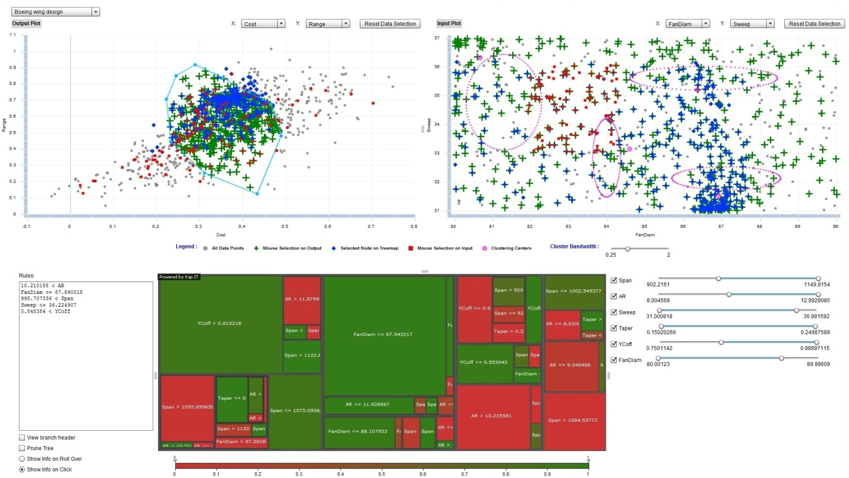
Visualization System: LIVE

Slide 8
Advances: Publication
J. Li, S. Ray, B. G. Lindsay, “A nonparametric statistical approach to clustering via mode identification,” Journal of Machine Learning Research, 8(8):1687-1723, 2007.
M. Qiao, J. Li, “Two-way Gaussian mixture models for high dimensional classification”, Journal of Statistical Analysis and Data Mining, vol.3(4), pp.259-271, 2010.
H. M. Lee, J. Li, “Variable selection for clustering by separability based on ridgelines,” submitted to journal, 2010.
J. Li, M. Qiao, T. Simpson, X. Yan, X. Zhang, “Facilitating knowledge discovery and decision making in engineering design with multidimensional data mining and clustering,” In Preparation for Journal of Engineering Design: Special Issue on Design Creativity.
Online demo for LIVE:
http://gmmv.ist.psu.edu/demo.html

Slide 9
Participation in Community
Participation in FODAVA workshops by X. Zhang
Attendee, Forum of FODAVA: Geometric Aspects of Machine Learning and Visual Analytics, VisWeek, October, 2009
Attendee, Workshop of Extreme Scale Visual Analytics, VisWeek, October, 2010
Invited session organized by J. Li in Joint Statistical Meetings (JSM), Vancouver, Canada, July 2010: Statistical Modeling and Learning for Information Visualization and Dimension Reduction
“Energy functions for Nonlinear Dimension Reduction and Graph Visualization,” L. Chen, Yale University
“Penalized Matrix Classification Analysis in Classifying Volatile Chemical Toxicants,” W. Zhong, UIUC
“A Comparative Study of Variable Screening Methods: Univariate versus Multivariate Screening,” C. Liu, T. Shi, and Y. Lee, Ohio State University
“Mode Based Clustering with Applications to Information Visualization,” J. Li, X. Zhang, Penn State University
Invited Panelist: X. Zhang
Panel of Visualization and Rich Data Sets in the Annual Workshop of Human-Computer Interaction Consortium, February, 2010
Panel Presentation: Interactive Visualization of Large Data Sets: Challenges and Some Preliminary Answers

Slide 10
Future Directions
Methodology:
Regularized mixture modeling by exploiting geometric characteristics of kernel density or mixture density.
Parallel computing for statistical learning methods to improve efficiency of interactive visualization.
Visualization system:
Work with researchers on engineering design to add new functions and to enhance existing ones for the LIVE system.
Evaluate the LIVE system.
Applications:
Test the data summarization method for meteorology data by embedding it into weather prediction model.
Explore other pattern recognition problems faced by meteorologists.
Explore new challenges faced in engineering design.

