Slide 1
Modeling the Uncertainty Due to Data/Visual Transformations using Sensitivity Analysis
This project proposes to study sensitivity analysis for guiding the evaluation of uncertainty of data in the visual analytics process. We aim to achieve:
  Semi-automatic Extraction of Sensitivity Information
  Differential and Sampling-based Sensitivities of Graph-based Metrics and Transformations
  Sensitivity-guided Visual Representations and Interaction
PI: Kwan-Liu Ma
Co-PI: Carlos Correa (now at Google)
Postdoc: Yingcai Wu (now at MSRA)
PhD Students: Yu-Hsuan Chan and Tarik Crnovrsanin
Period: 9/2010-8/2012 (NCE to 8/2013)
Amount: $316,918.00
Notes:
We study sensitivity analysis to guide the evaluation of uncertainty of data in the visual analytics process. This represents a new, variational view of the visual analytics process, which considers data and visual transformations in terms of their extent to change the stability regions of the input data. As the process is a complex network of transformations, the ensuing sensitivity information forms a multi-dimensional collection of dependent variables, which implies novel and scalable visual representations. Sensitivity coefficients of data and visual transformations are useful for discovering the factors that mostly contribute to output variability, help finding stability regions of the different transformations within the original data space, and tell the analyst what is the interaction between variables, outputs and transformations.
1

Slide 2
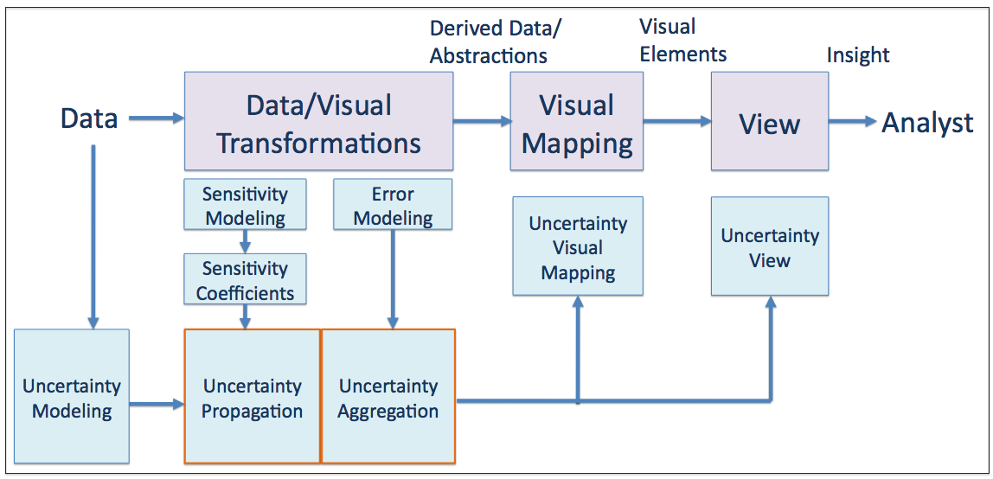
A Framework for Uncertainty-Aware Visual Analysis
Formalize the representation of uncertainty & basic operations
Quantify, propagate, aggregate, and convey uncertainty introduced over a series of data transformations
Enhance and evaluate visual reasoning in an uncertainty aware manner with this framework
Notes:
We have developed a framework to study incorporating uncertainty information throughout the process of visual analytics. In particular, we are concerned with how commonly employed data transformations are sensitive to data uncertainty. Sensitivity analysis focuses on the data and visual transformations. Instead of a particular estimate of the data uncertainty (which requires uncertainty modeling), we focus on the sensitivity of the output for either the full parameter space of the input (via the derivatives of the transformation), or for a representative sampling of the input space (via sampling methods). The resulting sensitivities are mapped to visual representations directly,or as summary views.
2

Slide 3
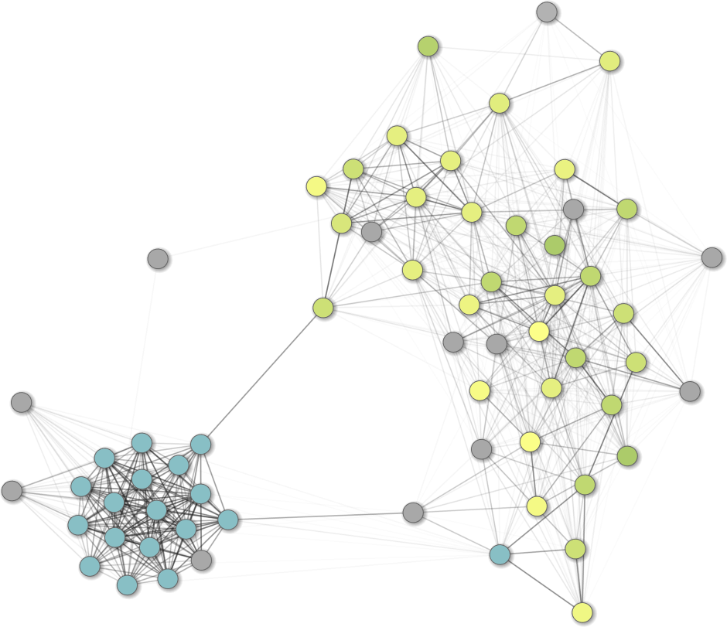
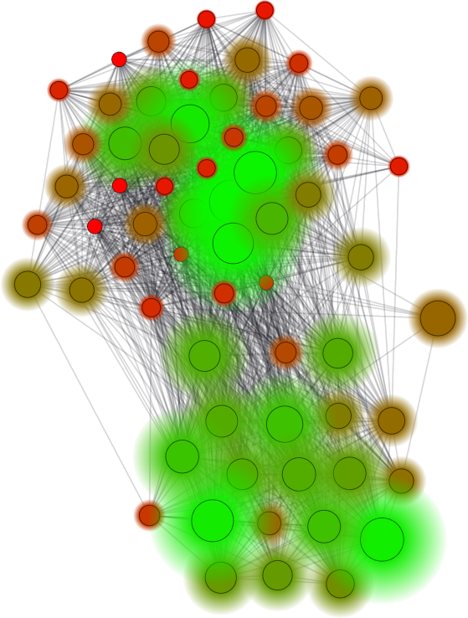
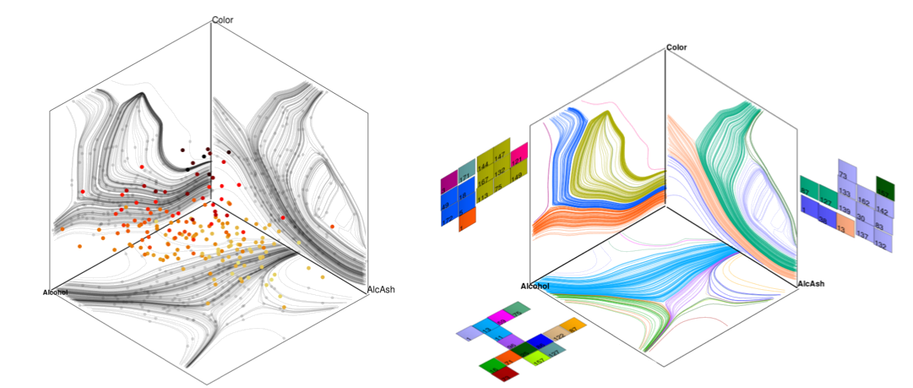
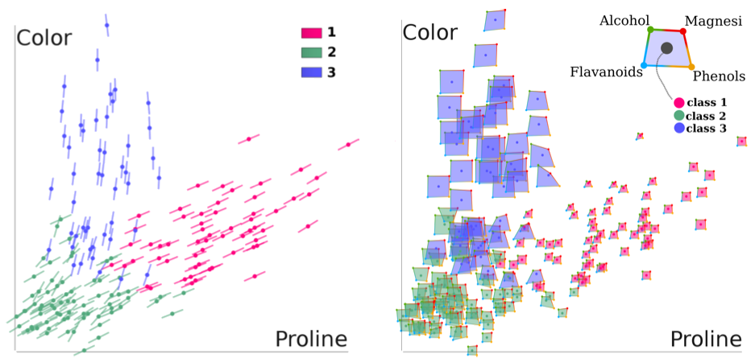
Overview of Accomplishments
Centrality Sensitivity
Centrality Uncertainty
Flow-based Scatterplot
Generalized Sensitivity Scatterplot
Regression Cubes
Notes:
Slide 3 - High level overview of your most important technical achievement under the project. Focus on the problem on this slide.
KLM: You will mention both Carlos and Yu-Hsuan's works using this slide.
Carlos' work is reported in this paper: http://vis.cs.ucdavis.edu/papers/social-networks-centrality.pdf
3

Slide 4
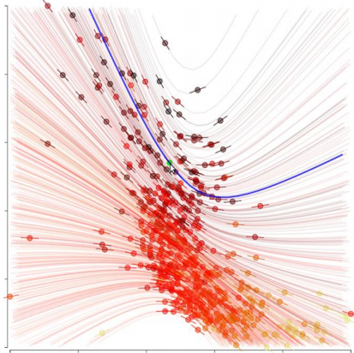
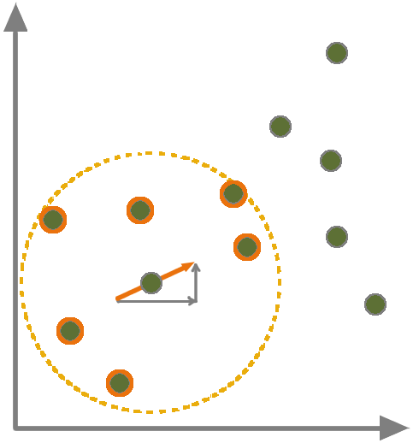
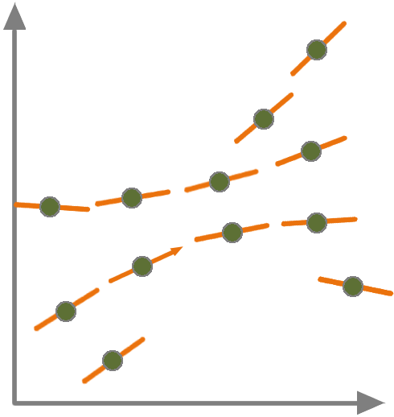
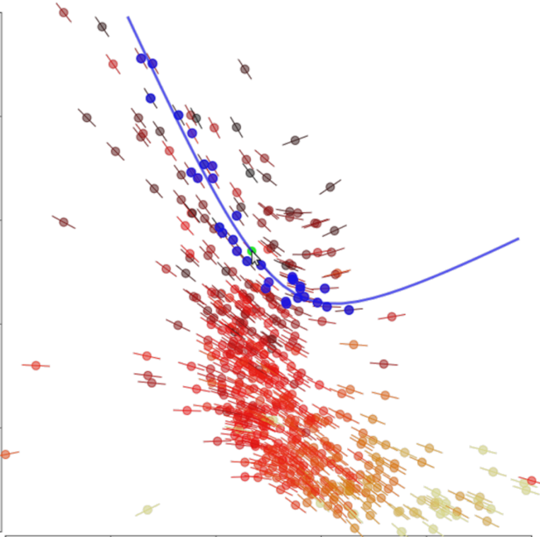
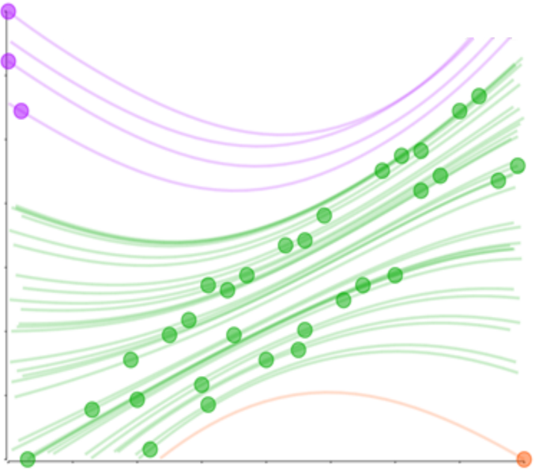
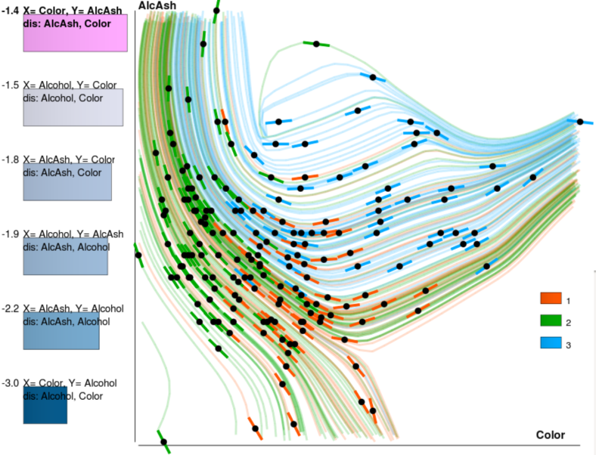
Flow-based Scatterplots
Sensitivity Derivatives are estimated by local linear regression in (X,Y).
Streamlines are integrated similarly.
Select by a flow line
Cluster by flow lines
Rank Projections
Flow-based Scatterplots for Sensitivity Analysis, VAST 2010
Notes:
A traditional scatterplot is useful to show correlation between two variables
It is common to augment scatterplots with linear trends, but they are usually sensitive to outliers.
In this paper, we augment scatterplots with local trend lines,
and borrow ideas from flow visualization to show the streamline of each data.
This new type of scatterplot provides the user novel operations, such as
- selecting by streamline
- clustering by trend
- ranking projections for multi-dimensional data (measure how good a 2D projection is by smoothness; exploration.

Slide 5
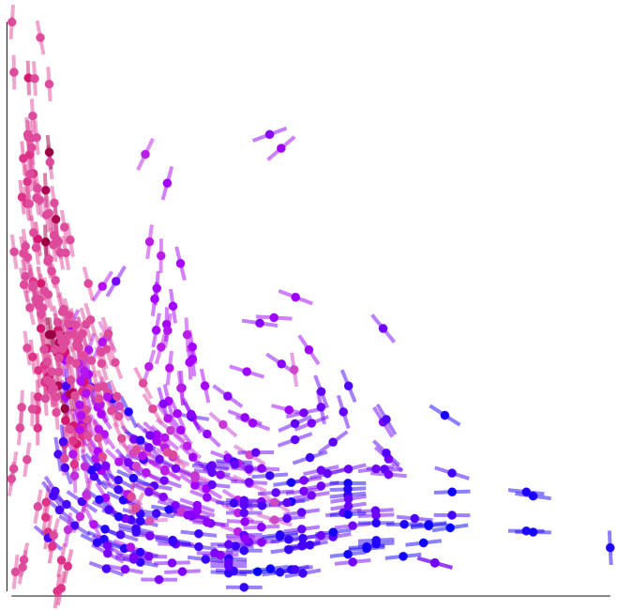
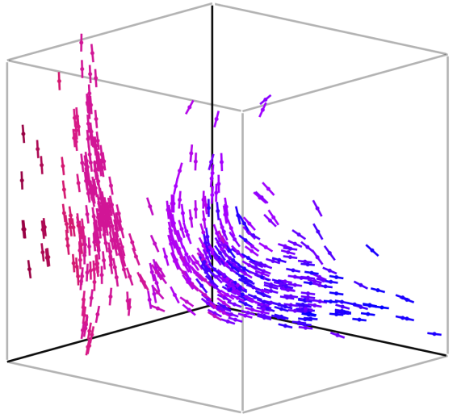
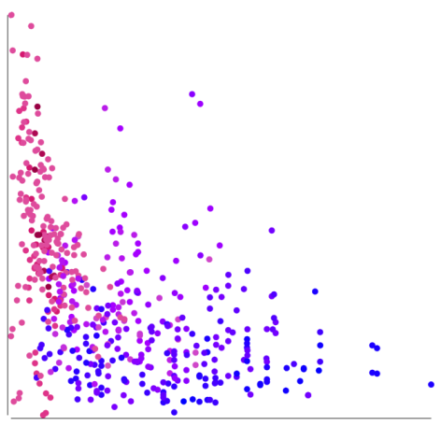
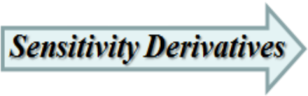
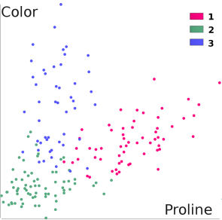
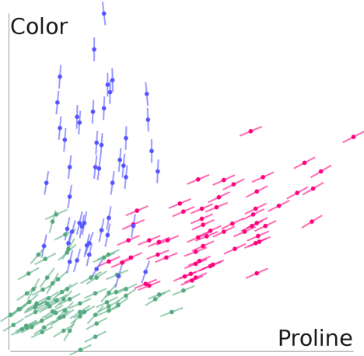
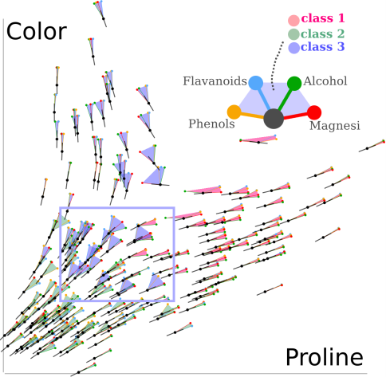
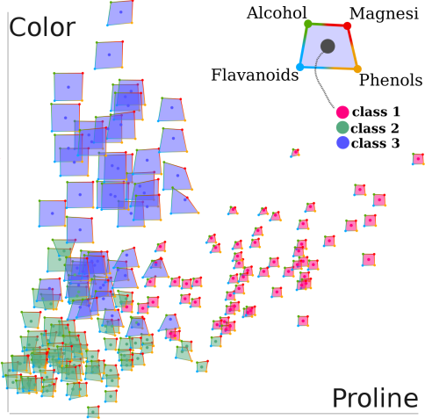
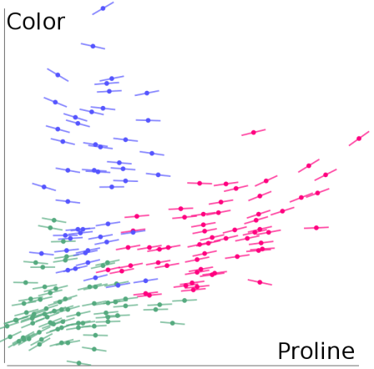
Generalized Sensitivity Scatterplots
Y
Z
X
Sensitivity Derivatives are estimated by linear regression in a local neighborhoood of (X, Y, Z) in R3
Flow-based scatterplot
GSS in R3
Sensitivity Fans
Sensitivity Star Glyphs
The Generalized Sensitivity Scatterplot , submitted to TVCG
Notes:
Then we generalized the sensitivity derivatives by estimating them in higher dimensional distances: n-D sensitivities.
To compare flow-based scatterplot and GSS:
Flow-based scatterplots are smooth and limited to the variables involved in a 2D projection,
i.e., differentiation occurs after projection.
Sensitivities could involve the full parameter space or selected subspaces.
So in GSS, we make use of these 2D sensitivities by inverting the order of the data transformations,
i.e., differentiation occurs before projection.
The higher dimensional relationships, as shown in the 3D view on the right,
can be implied in the 2D sensitivity derivatives visualizaion on the left.
An example is shown at the bottom: we see a 2D scatterplot of three classes of wines.
In Flow-based scatterplot, sensitivities reveal the positive correlated trend
between Color and Proline. However the three clasees are mixed up.
In GSS that sensitivities are differentiated by 3 dimensional space, two clearly distinct trend can be seen,
and we can differentiate class 3 wine in blue from other two classes;
Sensitivity fans in GSS compare multiple 3 dimensional sensitivities (by the slope) at once.
We can identify regions of a trend with little sensitivity to other dimensions by
very small fans (right most and topmost nodes);
large fans in the blue rectangle indicates data that Color are sensitive to Proline
when Flavavoid (blue fan line), Phenols (yellow line) or Magnessi (red line) are considered in differentiation.
We can also see that these points with big fans are class 3 wine (blue area spanned by big fans).
Then sensitivity star glyphs in GSS shows the magnitude of the 3D sensitivities.
We see now all the three classes of wines stands out distinctively by
the shape and the size of the star glyphs: class 3 wine (blue) > class 2 wine (green) > class 1 wine (pink).

Slide 6
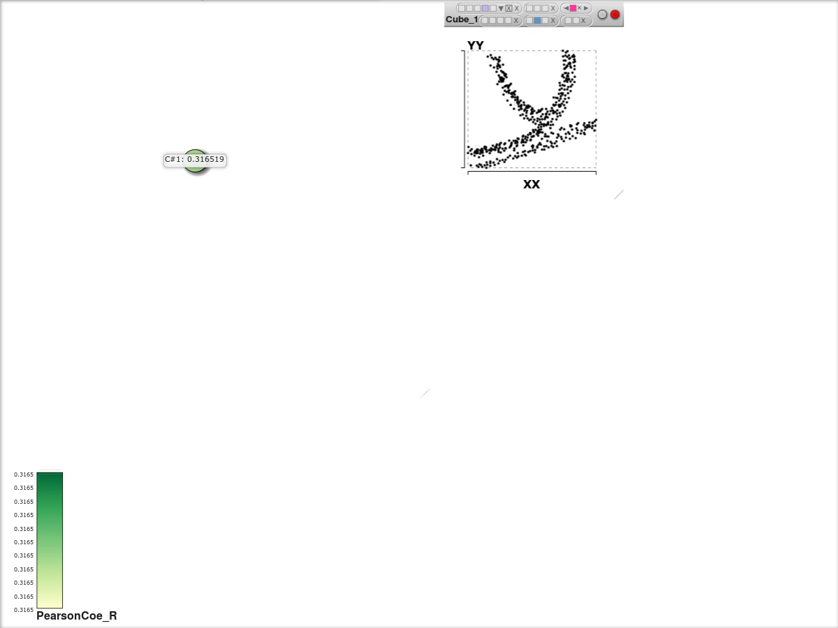


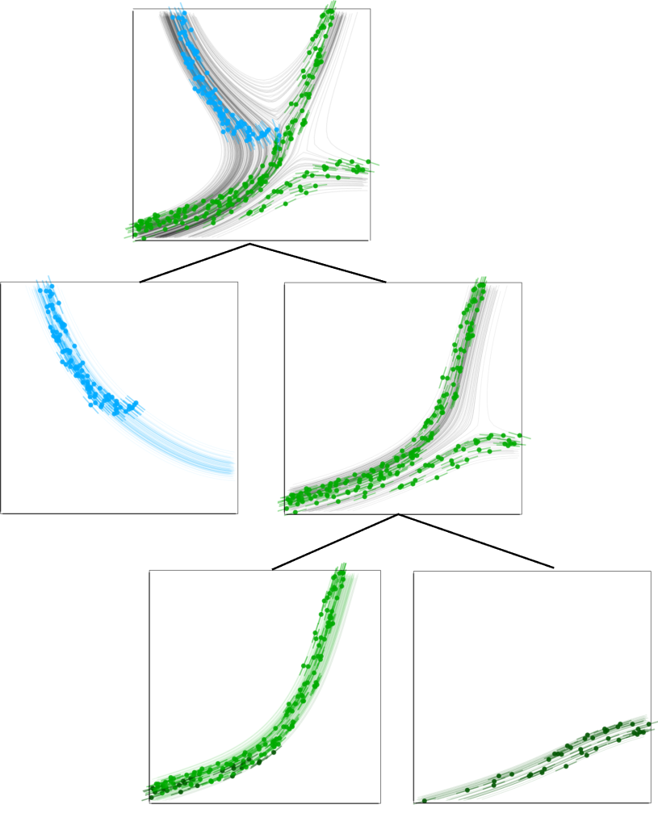
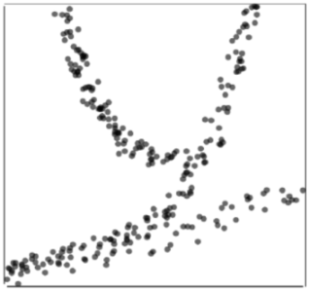
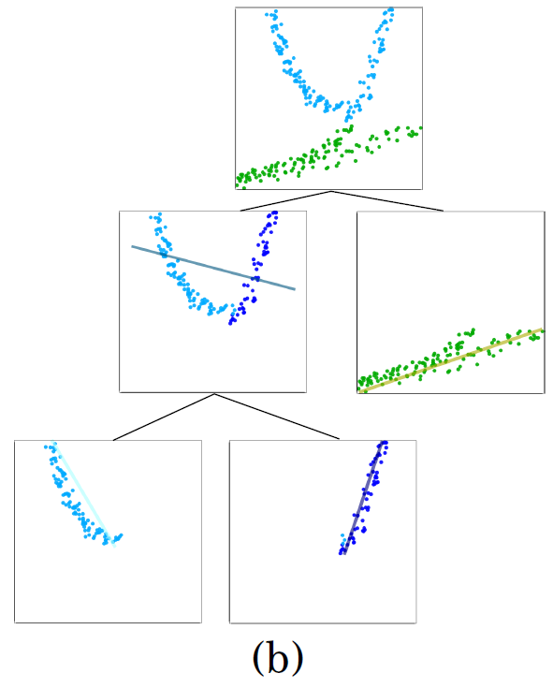
Regression Cubes
Sensitivity Selections
Rectangular Selections
Regression Cube: A Technique for Multidimensional Visual
Exploration and Interactive Pattern Finding, submitted to TiiS-VA
Notes:
Example synthetic data set containing regions of different trends.
Regression hierarchy by rectangular picking of points.
The first selection is split into two smaller linear trends (blue and purple).
A similar split could be carried in the remaining groups (green).
Regression hierarchy by sensitivity selection:
it is possible to easily select non-rectangular groups that have similar (non-linear) trend by flow line selection.
Now we see a split along a different selection, revealing three types of trends (by the leaf nodes of the hierarchy).
[video] http://vis.cs.ucdavis.edu/~chany/2012-0614_TiiS/TiiS_RegressionCube03.wmv
6

Slide 7
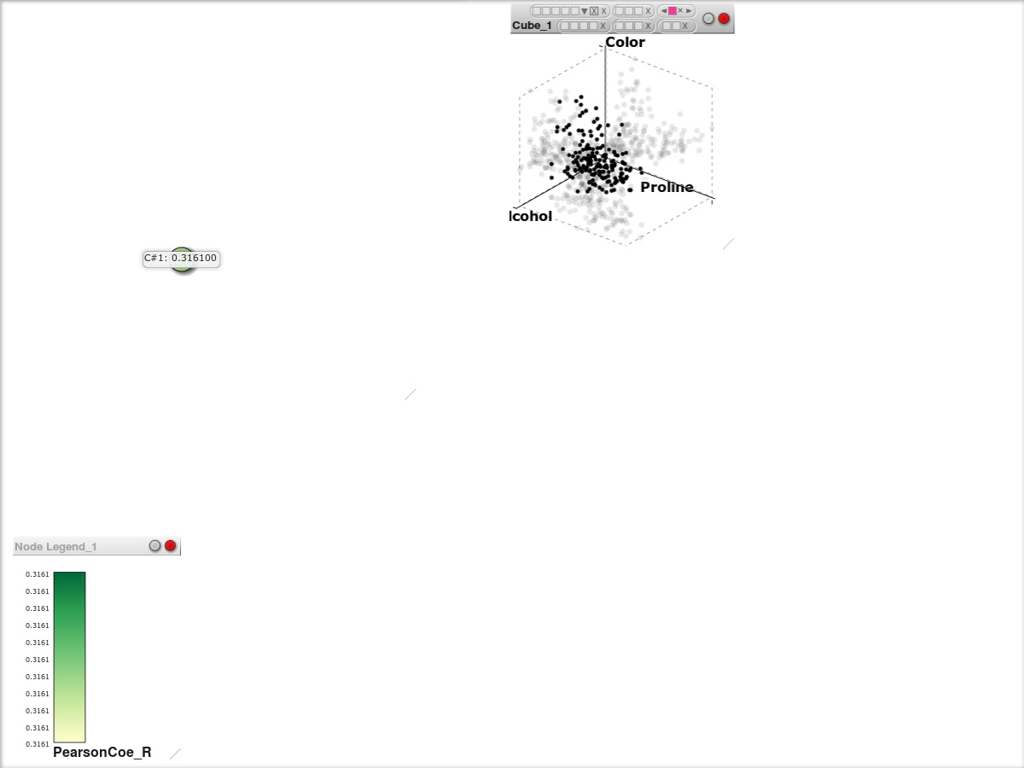
Regression Cubes
Sensitivity Selections
Rectangular Selections
Regression Cube: A Technique for Multidimensional Visual
Exploration and Interactive Pattern Finding, submitted to TiiS-VA
Notes:
Example synthetic data set containing regions of different trends.
Regression hierarchy by rectangular picking of points.
The first selection is split into two smaller linear trends (blue and purple).
A similar split could be carried in the remaining groups (green).
Regression hierarchy by sensitivity selection:
it is possible to easily select non-rectangular groups that have similar (non-linear) trend by flow line selection.
Now we see a split along a different selection, revealing three types of trends (by the leaf nodes of the hierarchy).
[video] http://vis.cs.ucdavis.edu/~chany/2012-0614_TiiS/TiiS_RegressionCube03.wmv
7

Slide 8
Results & Impact
Visualizing Flow of Uncertainty through Analytical Processes, InfoVis 2012
Design Considerations for Optimizing Storyline Visualization, InfoVis 2012
Visual Cluster Exploration of Web Clickstream Data, VAST 2012
Visual Analysis of Massive Web Session Data, LDAV 2012
Clustering, Visualizing, and Navigating for Large Dynamic Graphs, Graph Drawing 2012
Ambiguity-Free Edge-Bundling for Interactive Graph Visualization, 18(5), IEEE TVCG 2012
Visual Reasoning about Social Networks using Centrality Sensitivities, 18(1), IEEE TVCG 2012
Visual Recommendations for Network Navigation, EuroVis 2011
Visualizing Social Networks, Chapter 11, Social Network Data Analytics, Springer 2011

Slide 9
Extensions and Outreach
Kwan-Liu Ma
SDAV: Scalable Data Management, Analysis and Visualization, UC Davis PI, $425,000.00 per year (2012-2017), DOE SciDAC
Co-Founder of IEEE Symposium on Large Data Analysis and Visualization (LDAV), 2011
IEEE LDAV 2011, PI, $9,637.00, NSF
Symposium Co-Chair, LDAV 2011
LDAV Steering Committee
Co-Chair, the 7th Ultra-Scale Visualization Workshop, SC12
Guest Editor, Big Data Visualization, IEEE Computer Graphics & Visualization, July/August 2013

Slide 10
More Extensions & Outreach
Kwan-Liu Ma
Three new projects on visual analytics for cyber intelligence with Northrop Grumman
A new visual analytics project with HP Lab
UC Davis Center for Visualization
UC Davis Big Data Implementation Committee
Selected invited talks on Big Data Visualization
  SIGGRAPH Asia Workshop on Visualization, 2012
  UC Irvine CS Distinguished Lecture, 2012
  Seoul National University, 2012
  HP Lab, 2012
  IBM Almaden Research Center, 2012
  AMP Lab, UC Berkeley, 2011
  Keynote, PacificVis 2011
  XLDB 2011
  CEA/EDF/INRIA Summer School, France, 2011

Slide 11
Thanks
Papers at
  http://vidi.cs.ucdavis.edu/research/uncertaintyvis
Questions?

