Slide 1
Formal Models, Algorithms, and Visualizations for Storytelling Analytics
Naren Ramakrishnan, Chris North, Francis Quek
Discovery Analytics Center
Department of Computer Science
Virginia Tech, Blacksburg, VA 24061
Notes:
This work summarizes research in our group over the past few years.

Slide 2
Goals of this project
To develop formal models, algorithms, and visualizations for storytelling in large datasets
Applications in intelligence analysis, cyber-security, and biological knowledge discovery

Slide 3
Goal: Connecting the dots
Pyotr Safrygin was formerly director of security at the Vector institute in Strizi, Russia. He now holds the position of director of security for Central Russia Airlines. He was born in Lipetsk, Russia on 26 December, 1950 and now lives in Moscow.
Information was requested of Belgian intelligence by the FBI on 1 September about Pieter Dopple, who lives at 22 Hoveniersstraat, Antwerp, Belgium. He sent the diamonds to Adnan Hijazi as noted in the USCBP report of 12 July, 2004. …. that they were from Peshawar in Pakistan.
?
Notes:
Here’s an example.
This is taken from an analytics competition that runs every year.
On the left is a …

Slide 4
Goal: Connecting the dots
Pyotr Safrygin was formerly director of security at the Vector institute in Strizi, Russia. He now holds the position of director of security for Central Russia Airlines. He was born in Lipetsk, Russia on 26 December, 1950 and now lives in Moscow.
Information was requested of Belgian intelligence by the FBI on 1 September about Pieter Dopple, who lives at 22 Hoveniersstraat, Antwerp, Belgium. He sent the diamonds to Adnan Hijazi as noted in the USCBP report of 12 July, 2004. …. that they were from Peshawar in Pakistan.
Intercepted phone call on 5 September, 2004 from a phone at Central Russia Airlines in Moscow to an unlisted cell phone in Karachi, Pakistan. The caller says [in Russian]: "I got the first payment and have obtained what you wanted. Let me know when you wish me to ship this stuff." The recipient of the call says: "Fine, it will not be too long now."
…. call from a location in Karachi, Pakistan to a location in Panama City, Panama. The location in Karachi is # 631 Nishtar Rd; the location in Panama City is 993 Panamico Ave. The caller says: "Can you help us sell a large assortment of very high quality tanzanite and diamond in a short time?" The person receiving the call says: "Yes, will the payment go to the usual place?" The caller replies: "Yes, for this shipment, …"

Slide 5
Storytelling

Slide 6
Biomedical discovery
K.N. Maclean, M. Janosík, E. Kraus, V. Kozich, R.H. Allen, B.K. Raab, J.P. Kraus, Cystathionine beta-synthase is coordinately regulated with proliferation through a redox-sensitive mechanism in cultured human cells and Saccharomyces cerevisiae, J Cell Physiol, Vol. 192 No. 1, pages 81–92, Jul 2002.
M.B. Roth and T. Nystul, Buying time in suspended animation, Scientific American, Vol. 292, No. 6, pages 48-55, June 2005.
Hydrogen sulfide
CBS domains
L. Schmitt and R. Tampe, Structure and mechanism of ABC transporters, Current Opinion in Structural Biology, Vol. 14, No. 4, pages 426-431, Aug 2004.
C. Tang, X. Li and J. Du, Hydrogen sulfide as a new endogenous gaseous transmitter in the cardiovascular system, Current Vascular Pharmacology, Vol. 4, No. 1, pages 17-22, Jan 2006.
Molecular complexes
of CBS domains
Ligands bound
to CBS domains
J.W. Scott, S.A. Hawley, K.A. Green, M. Anis, G. Stewart, G.A. Scullion, D.G. Norman, and D.G. Hardie, CBS domains form energy-sensing modules whose binding of adenosine ligands is disrupted by disease mutations, Journal of Clinical Investigation, Vol. 113, No. 2, pages 182-184, Jan 2004.

Slide 7
Proposed Technical Approach
Develop a formal model of storytelling, using redescriptions and biclusters as a way to create shifts-of-vocabulary across diverse domains
Design scalable and steerable algorithms that can respond to interactive user input such as preferences and constraints
Investigate how analysts gain insight through storytelling visualizations

Slide 8
High-level overview of most important technical achievement
Problem Statement
How can we find stories through diverse datasets that are contextually coherent?
Notes:
We would like to find stories that do not meander, that do not simply connect things arbitrarily, but that can be effectively summarized at the end of the day using logical explanations

Slide 9
High-level overview of most important technical achievement
Approach
Use biclusters and redescriptions to bridge diverse data domains
Develop exploratory tools using these concepts and embed in a visual analytic system
Conduct user studies to evaluate impact on discovery process and product
Notes:
We would like to find stories that do not meander, that do not simply connect things arbitrarily, but that can be effectively summarized at the end of the day using logical explanations
Biclusters provide a certain level of coherence and organization for stories.

Slide 10
Approach: Clique Chains

Slide 11
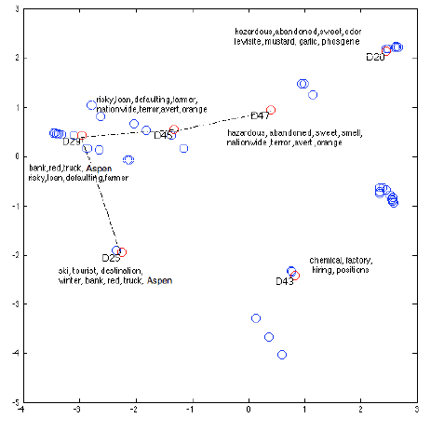
Injecting user feedback
Story :
D25->D29
->D45->D47

Slide 12
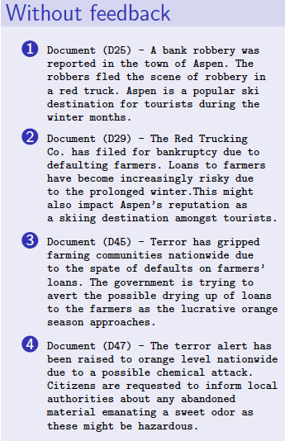
Not a great story

Slide 13
Injecting user feedback
Story :
D25->D29
->D45->D47

Slide 14
Injecting user feedback
Story :
D25->D29
->D45->D47
Analyst prefers story go through D43

Slide 15
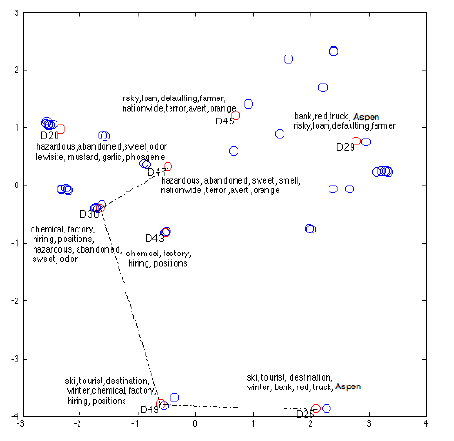
Injecting user feedback
Story :
D25->D29
->D45->D47
Analyst prefers story go through D43

Slide 16
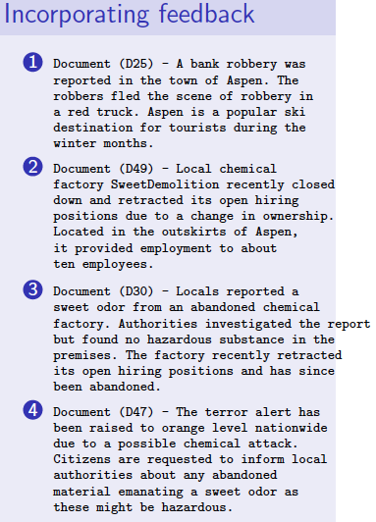
In plain English..

Slide 17
Translating feedback

Slide 18
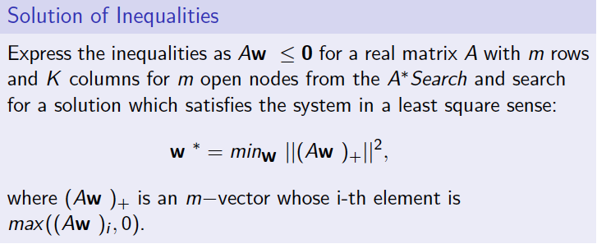
System of inequalities

Slide 19
Biclusters & Redescription
Phone Calls
Organizations
People
Places
Notes:
A story in a relational setting is then just an alternating application of biclustering and redescriptions.
Introduce the word biclusters here.

Slide 20
Computing βρβs
In order to find this
We would have to contend with this

Slide 21
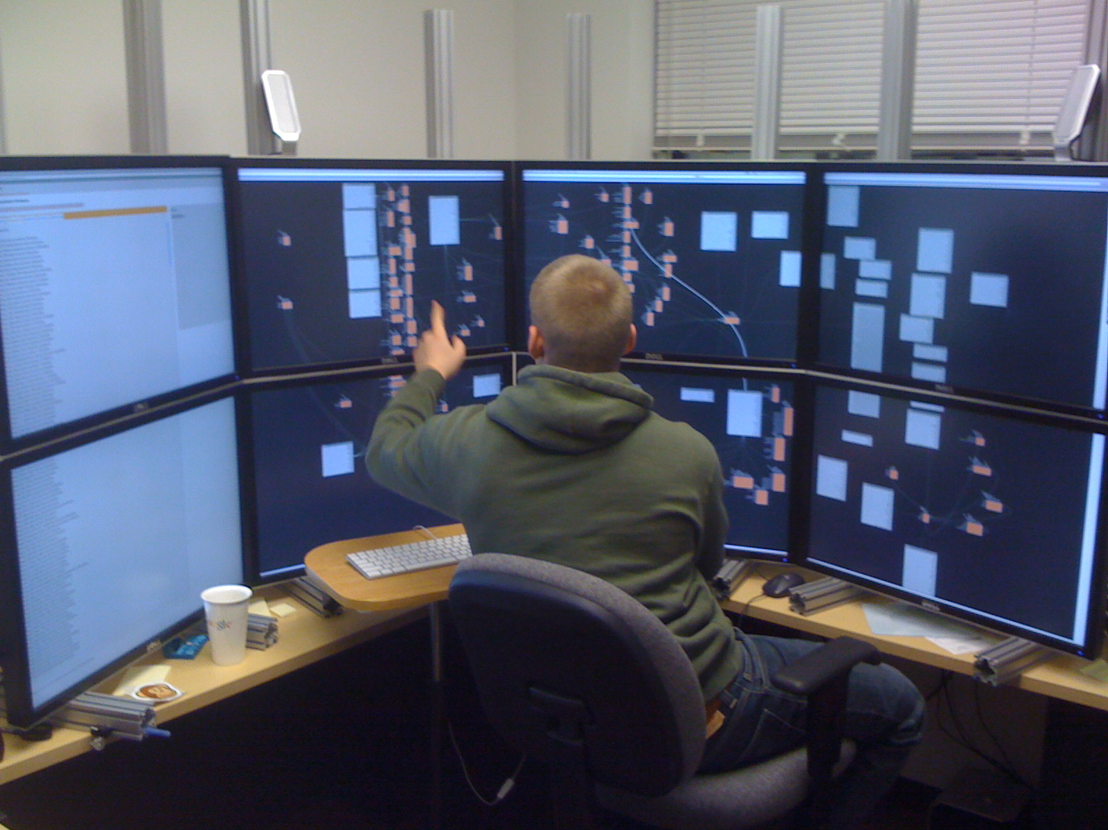
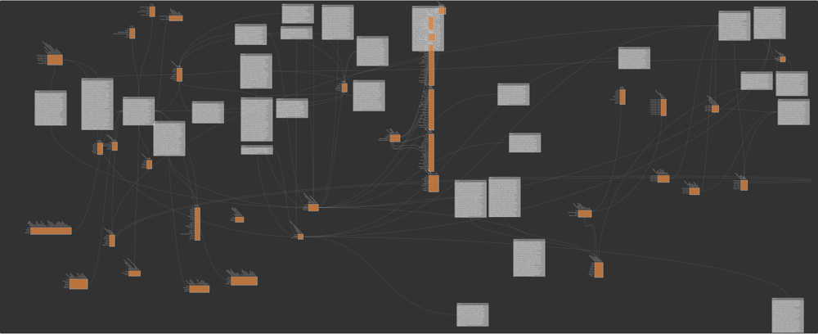
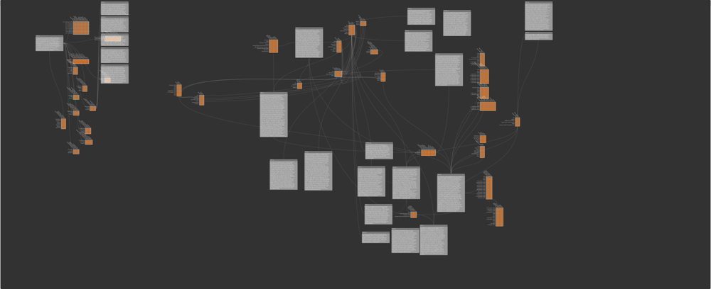
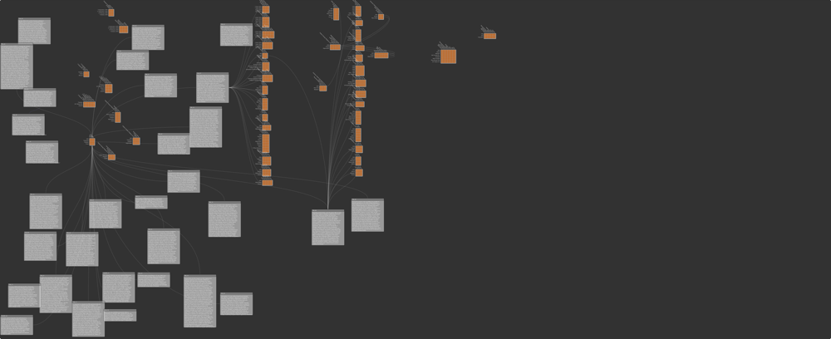
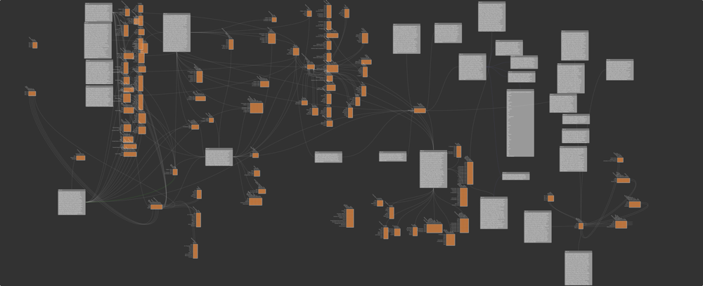
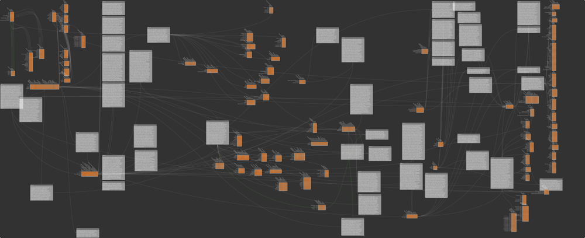
Bixplorer
Notes:
We have built Bixplorer.. We can study how users use Bixplorer using both their analytic process as well as product.
In terms of process, they successfully integated biclusters, use them as overviews and enabling rapid transitions between jumps.
In terms of product, biclusters are used as evidence to justify connections and artifacts for hypothesis description.
One of the issues with biclusters is: do they cause information overload, apparently not.

Slide 22
Solving the Crescent Scenario
This represents a full solution for the Crescent scenario using Bixplorer.

Slide 23
Crescent Scenario Full Workspace
This represents a full solution for the crescent scenario using minevis.

Slide 24
Crescent Scenario Cells
Orange = Abdul Ramazi – Coordinator
Green = Boston Harbor Plot – Cell #1
Blue = Atlanta Train Station Plot – Cell #2
Red = New York Stock Exchange Plot – Cell #3

Slide 25
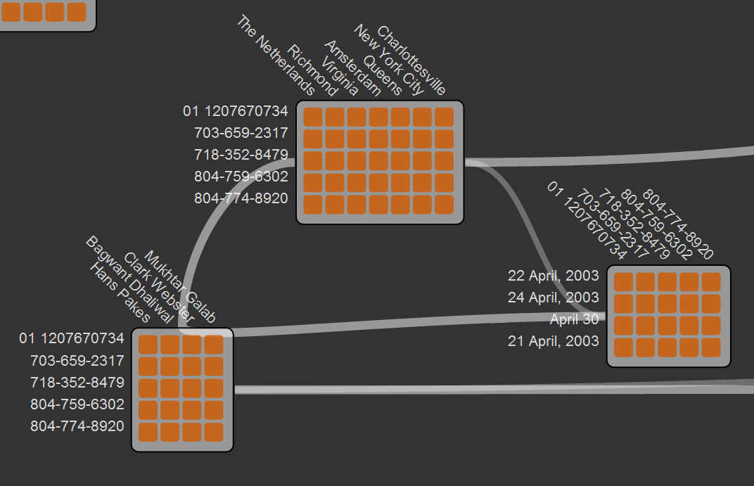
Analysis Starting Point: A Tale of 3 Biclusters
In this case the analyst decided to start with this story of biclusters linking a set of 5 phone numbers to names, locations and date.
In this case, it turns out that this odd group is central to communication and coordination between the cells and serves as an efficient starting point for analysis.

Slide 26
Extensions and outreach
Developed storytelling applications for biology, intelligence analysis
Won VAST 2011 Mini-Challenge Award
Ramakrishnan leads one of 3 IARPA OSI awards ($13M 3 years); a collaboration of Virginia Tech, UMD, Cornell, UCSD, SDSU, IU, CHB, CACI, Basis Technology
Other FODAVA PIs on this effort: Lise Getoor and Scotland Leman
Organized CHI 2011 Workshop on Analytic Provenance
4 PhD Dissertations
Publications in KDD, VAST, …
Notes:
OSI stands for the ‘open source indicators’ program.
UMD – University of Maryland
UCSD – Univ of California San Diego
SDSU – San Diego State University
IU - Indiana University
CACI – the company called CACI Inc.
Basis Technology – another company in the beltway area

Slide 27
Backup slides follow

Slide 28
Topics today
Path finding in a document similarity network
but with tight neighborhood constraints
cannot materialize the entire network
How can we structure the storytelling process for the analyst?
How can storytelling algorithms effectively incorporate user input?
Notes:
Items 2 and 3 are two parallel branches

Slide 29
Topics today
Path finding in a document similarity network
but with tight neighborhood constraints
cannot materialize the entire network
How can we structure the storytelling process for the analyst?
How can storytelling algorithms effectively incorporate user input?

Slide 30
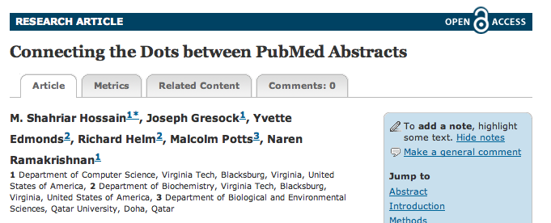
Storytelling in biomedical abstracts

Slide 31
Storytelling in biomedical abstracts

Slide 32
Algorithmic foundations
Path finding in a document similarity network
but with tight neighborhood constraints
cannot materialize the entire network
How can we structure the storytelling process for the analyst?
How can storytelling algorithms effectively incorporate user input?

Slide 33
Structuring the storytelling process
Analysts think in terms of entities, actions, and relations between them
Idea
“Relationalize” text
Develop compositional data mining algorithms to connect objects across diverse relations

Slide 34
Relationalizing Text
Use documents as the primary domain
People X Documents
Places X Documents
Dates X Documents
Use documents as the supporting relation
People X Places
Places X Dates

Slide 35
Relational stories
Phone Calls
Organizations
People
Places
Notes:
A story in a relational setting is then just an alternating application of biclustering and redescriptions.
Introduce the word biclusters here.

Slide 36
The unit of composition
βρβ patterns

Slide 37
Computing βρβs
In order to find this
We would have to contend with this

Slide 38
Two basic ideas
Compute then compose
Results in too many “orphans”
Compose then compute
Push compositionality into the data mining algorithm [ACM Trans. KDD’10]

Slide 39
Compose then compute

Slide 40
Compose then compute

Slide 41
Compose then compute

Slide 42
Compose then compute

Slide 43
Compose then compute

Slide 44
Compose then compute

Slide 45
Topics today
Path finding in a document similarity network
but with tight neighborhood constraints
cannot materialize the entire network
How can we structure the storytelling process for the analyst?
How can storytelling algorithms effectively incorporate user input?

Slide 46
Summary of posters
Bixplorer
Bundles relationships into biclusters for composition into a story
Interactive storytelling
Reweights documents based on user input over path constraints
Future
Visual analytics support for more such imprecise problems, e.g., “where do I start?”

